Slide 1
Artist Discovery System
By: Abdul Omotosho, Aziz Malouche, Pranav Poodari, Nikhil Sowdas

Slide 2



Problem Definition
The most popular streaming apps that we use everyday such as Spotify and Apple Music are great for finding popular music. However, they are not promoting new artists as often because they want to maintain listener retention. This has led to a demand for new music and artists that are not in mainstream media. We will create an application that will fix this and allow for all music and music lovers to come together.

Slide 3
Main Idea
Our project plan is to create an application that will allow users to listen and discover new music from up and coming artists in a wide variety of genres.
Our application will allow listeners and artists to create accounts which will have differing functionalities depending on the use case
Based on this, the system will then display various artists of differing genres for the listener to discover

Slide 4
Features by User Type
User / Listeners
Listen to music
Create/View playlists to enjoy
Discover new, unknown, artists
Follow their new favorite artists
Admins
Upload new music
Add new artists
Add new albums
Track streaming numbers and star ratings
Share music on social media

Slide 5
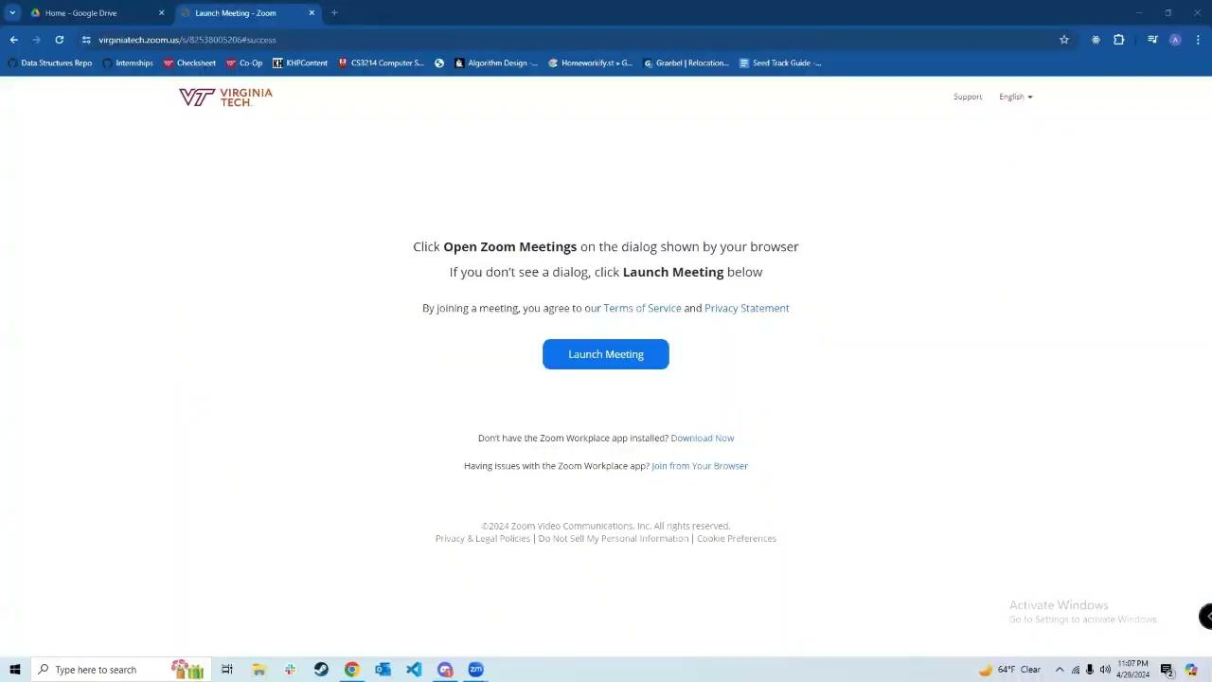

Slide 6
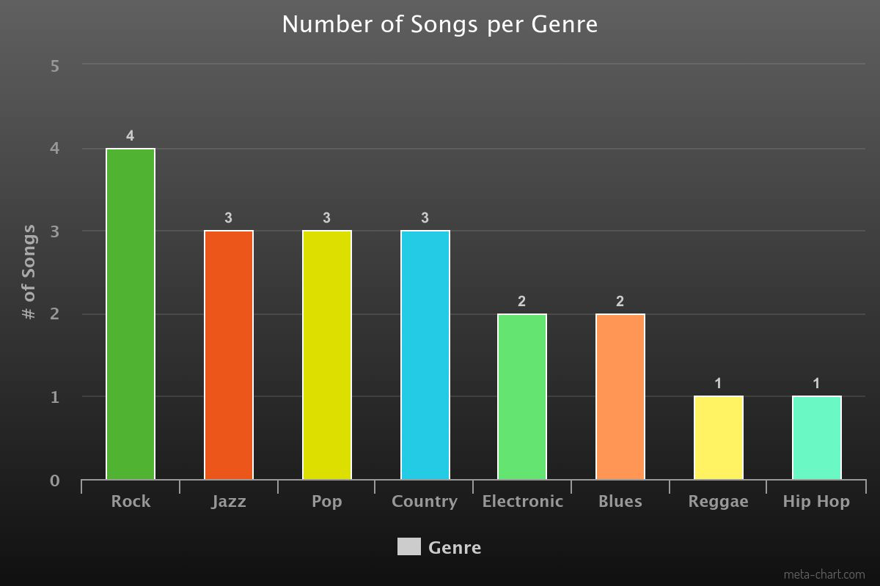
Statistical Reports

Slide 7
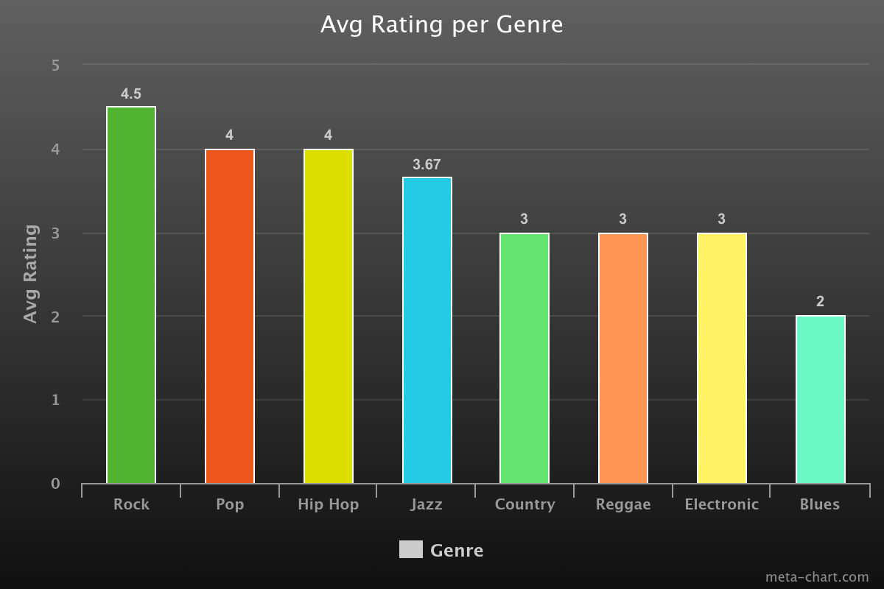
Statistical Reports(cont.)

Slide 8
Any Questions?

Slide 9


